Slide 1

WAY TO ENTERPRISE
AWS
VTI ACADEMY
Author: duy.nguyenngoc1@vti.com.vn

Slide 2
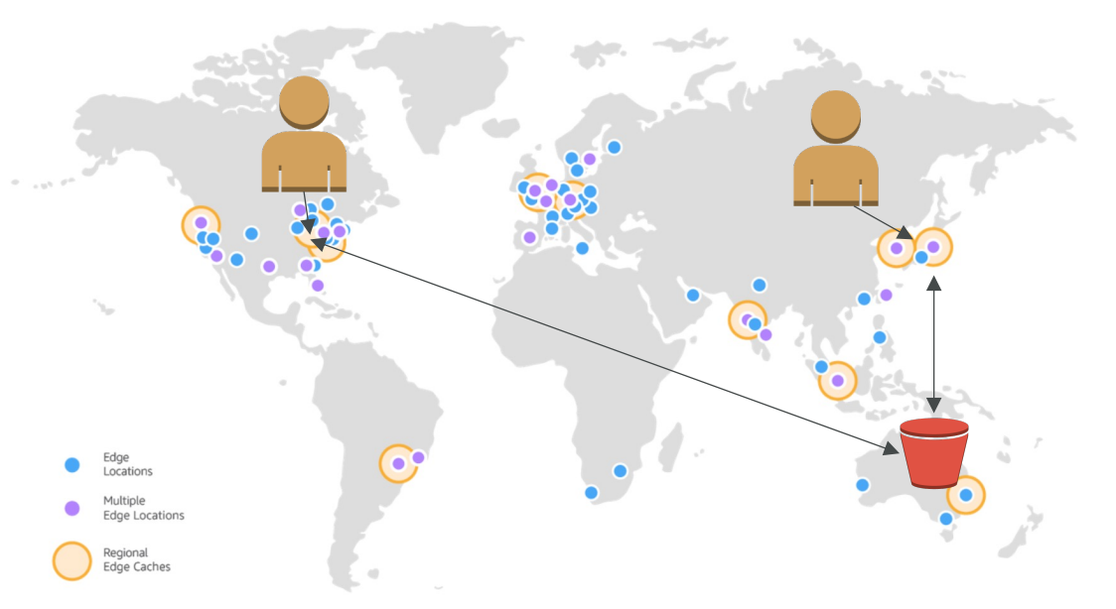
CloudFront Service
Is a CDN (Content delivery network), provide edge locations for caching content
Improves read performance, content is cached at the edge
Tutorial: https://docs.aws.amazon.com/AmazonCloudFront/latest/DeveloperGuide/Introduction.html

Slide 3
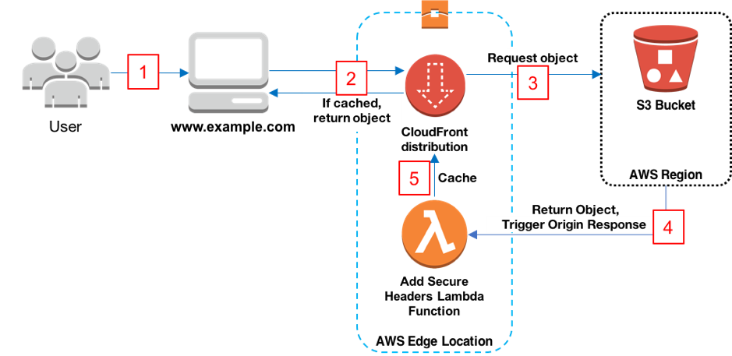
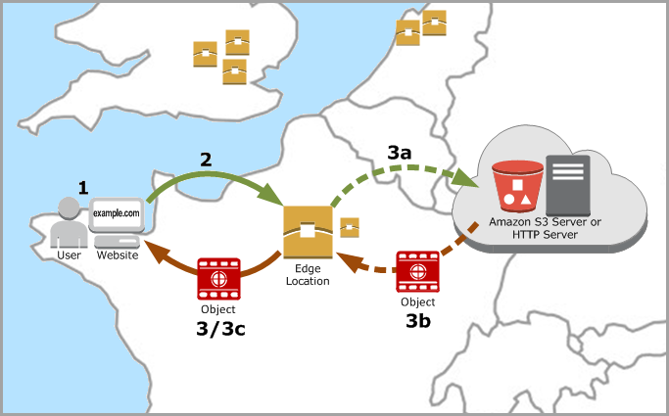
CloudFront Service
Flow
https://docs.aws.amazon.com/AmazonCloudFront/latest/DeveloperGuide/HowCloudFrontWorks.html

Slide 4
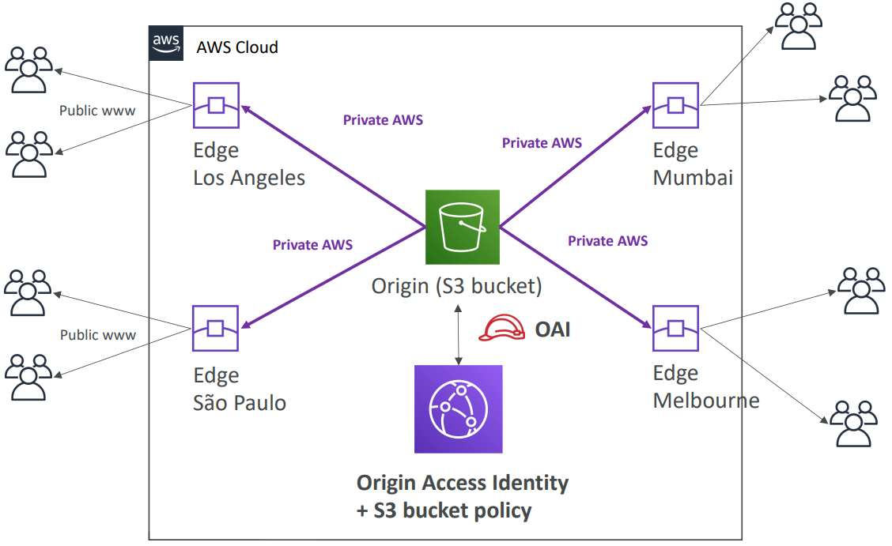
CloudFront Service
Usecases
  Website content (HTTP/HTTPS)
  On-demand video (VOD), live streaming video

Slide 5
CloudFront Service
Demo
  Hosting static web - S3
  Create CloudFront
  Test

Slide 6
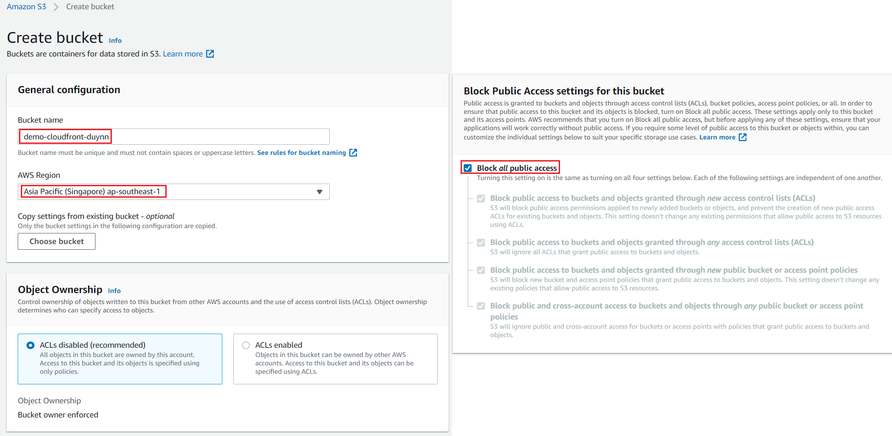
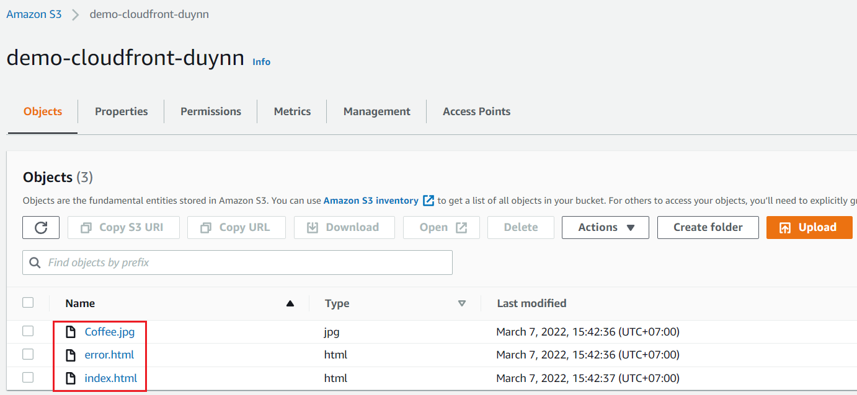
CloudFront Service
  Hosting static web – S3
Create bucket
Upload Objects

Slide 7
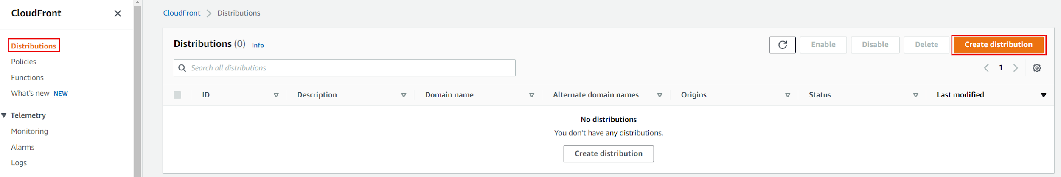
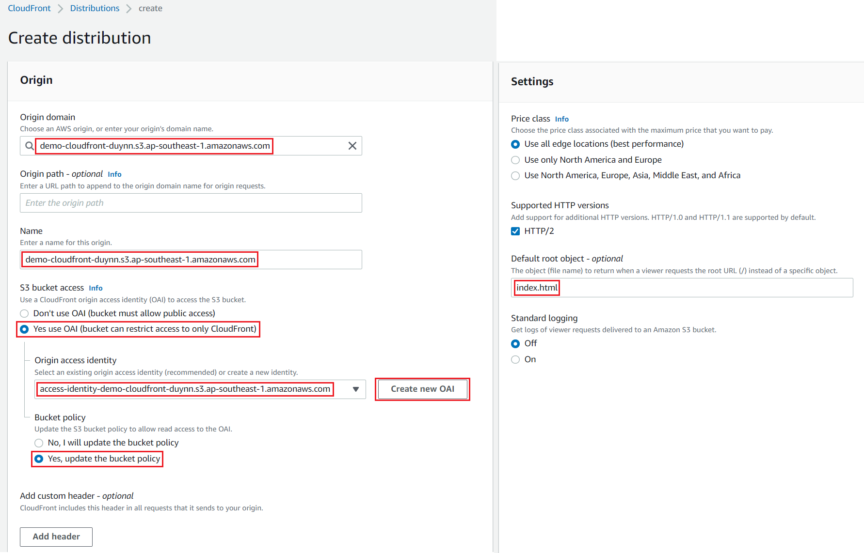
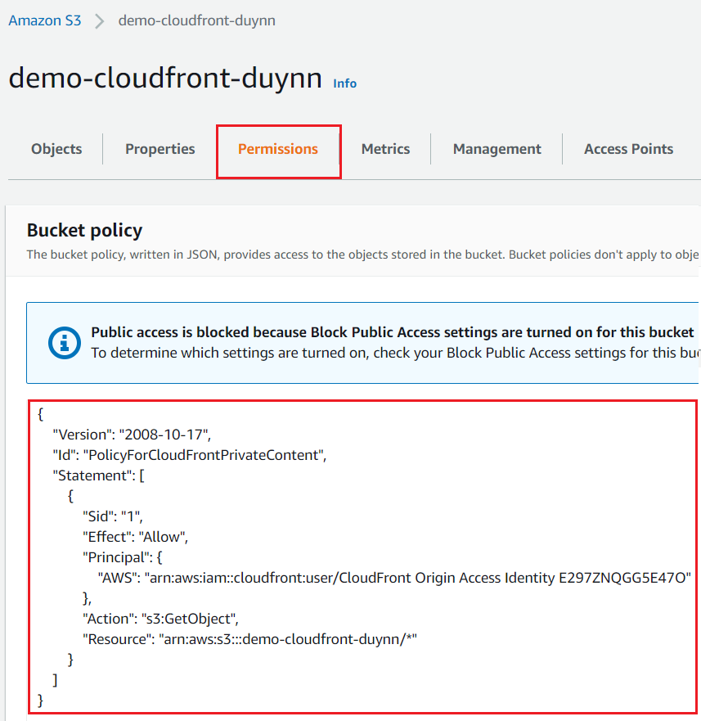
CloudFront Service
  Create CloudFront
Create CloudFront Distribution
S3 bucket policy

Slide 8
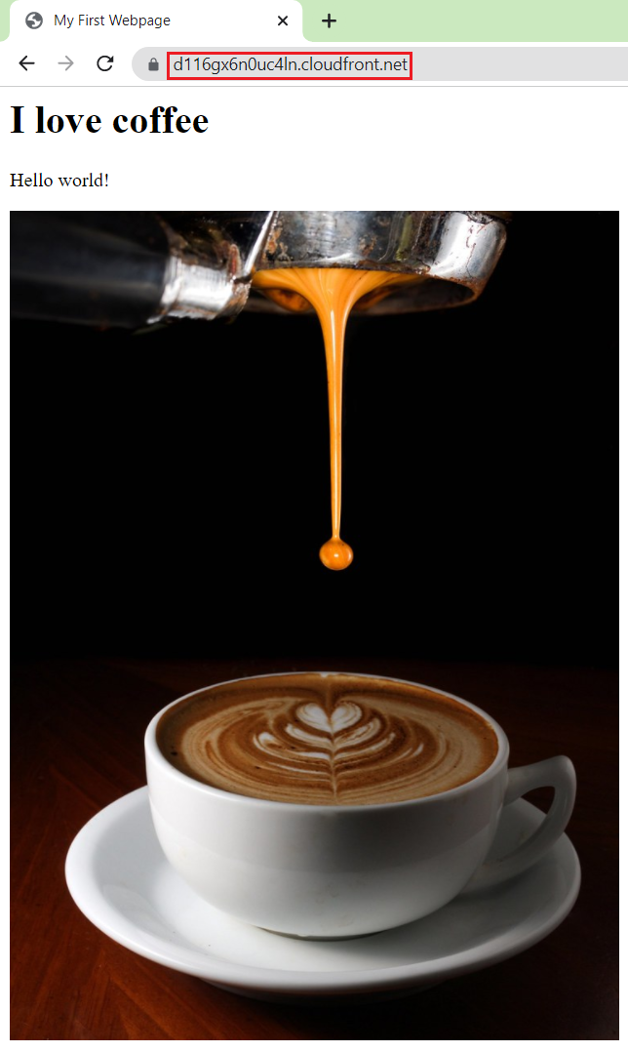
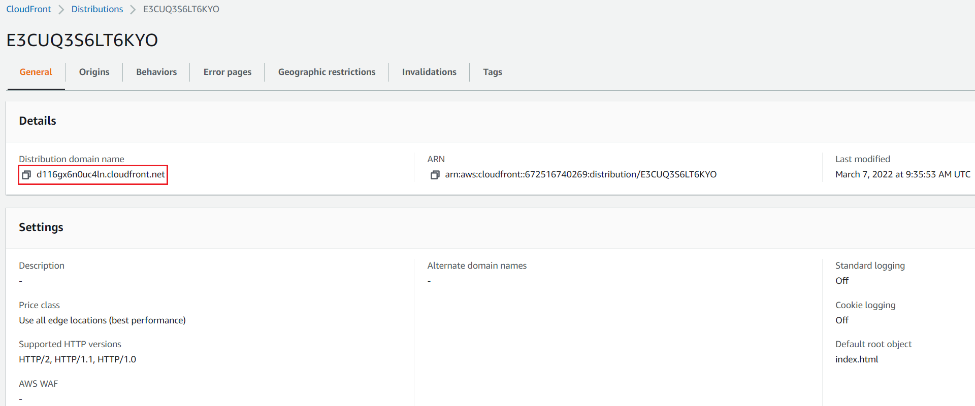
CloudFront Service
  Test

Slide 9
Assignment
  Self-practice

Slide 10
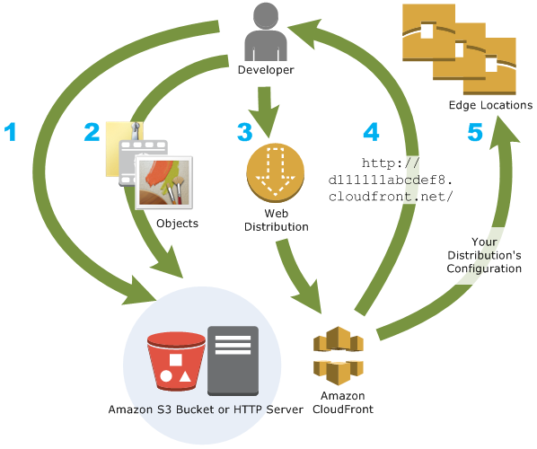
CloudFront Service
Components
  Origin Server & Origin Group
  Edge locations
  Settings

Slide 11
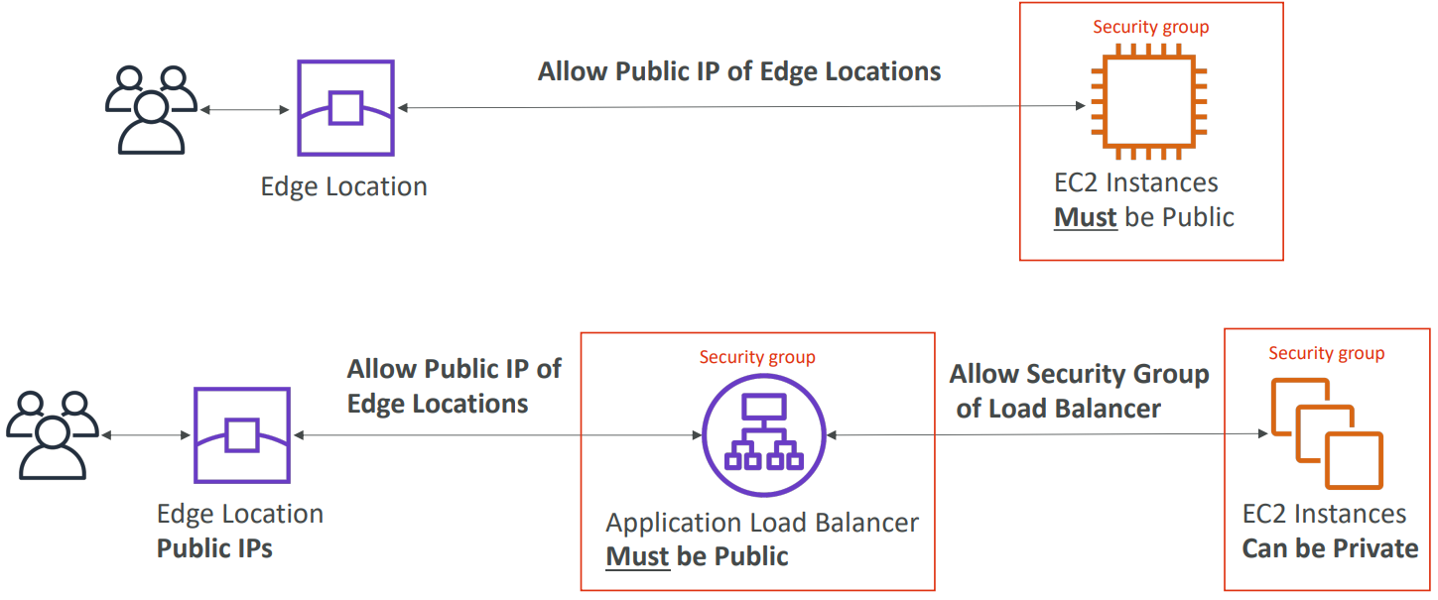
CloudFront Service
  Origin Server
    Support
      Origin server: S3 Hosting Website, ELB, web server running on EC2/on-premises …
      Object: web pages, images, files, …

Slide 12
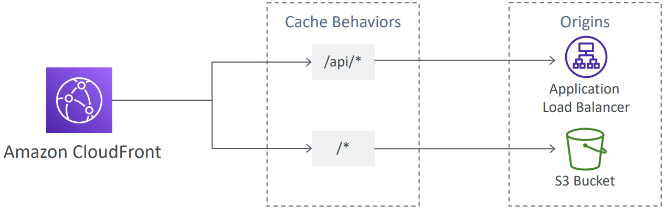
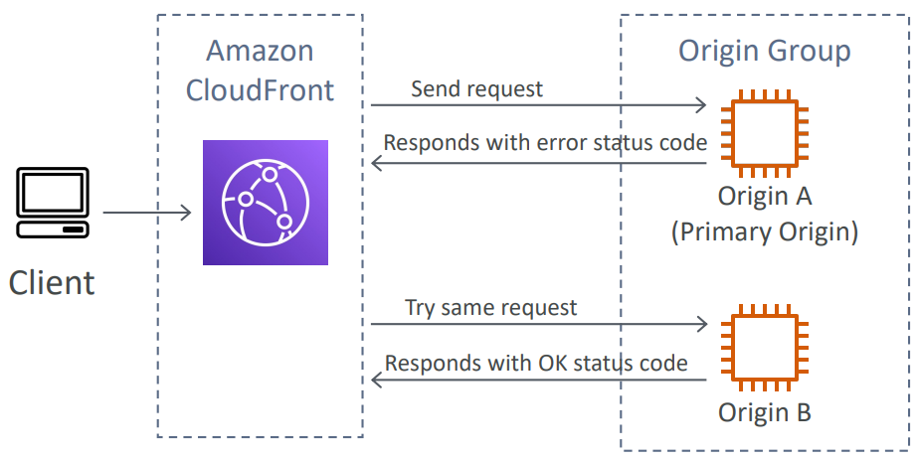
CloudFront Service
  Origin Group
    Including many Origins (one primary and many secondary origin)
    Support failover, Connection attempt, timeout, failover status code, Error page … for each origin
Route to different kind of origins based on the content type, path pattern
Failover

Slide 13
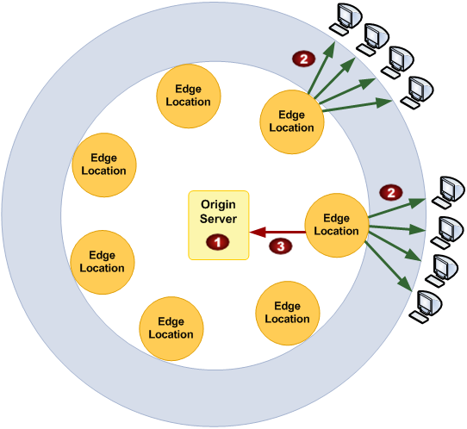
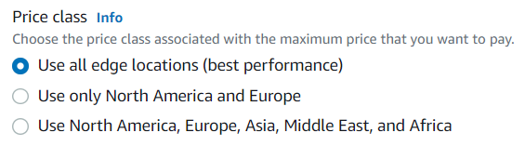
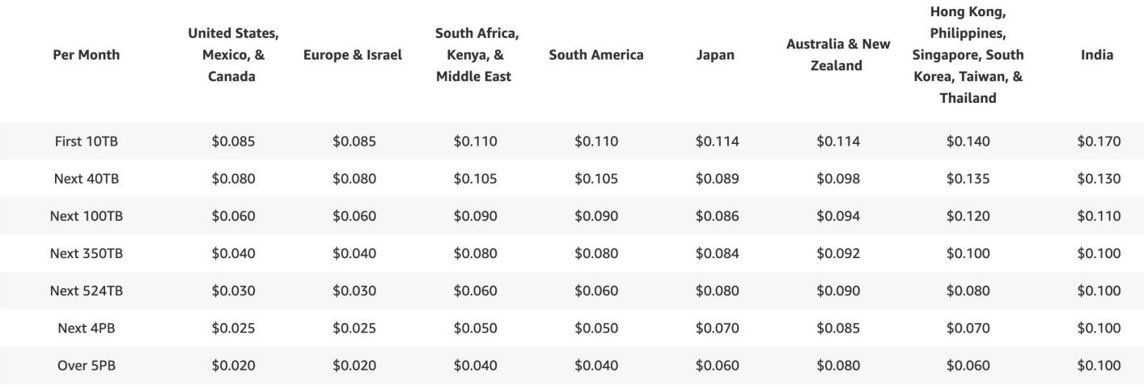
CloudFront Service
  Edge location - Points of presence (POPs)
    Is the point of catching content, locations are all around the world
    216 Point of Presence globally (edge locations)
    Price class: Choose an edge location for caching
https://aws.amazon.com/cloudfront/features/?nc=sn&loc=2

Slide 14
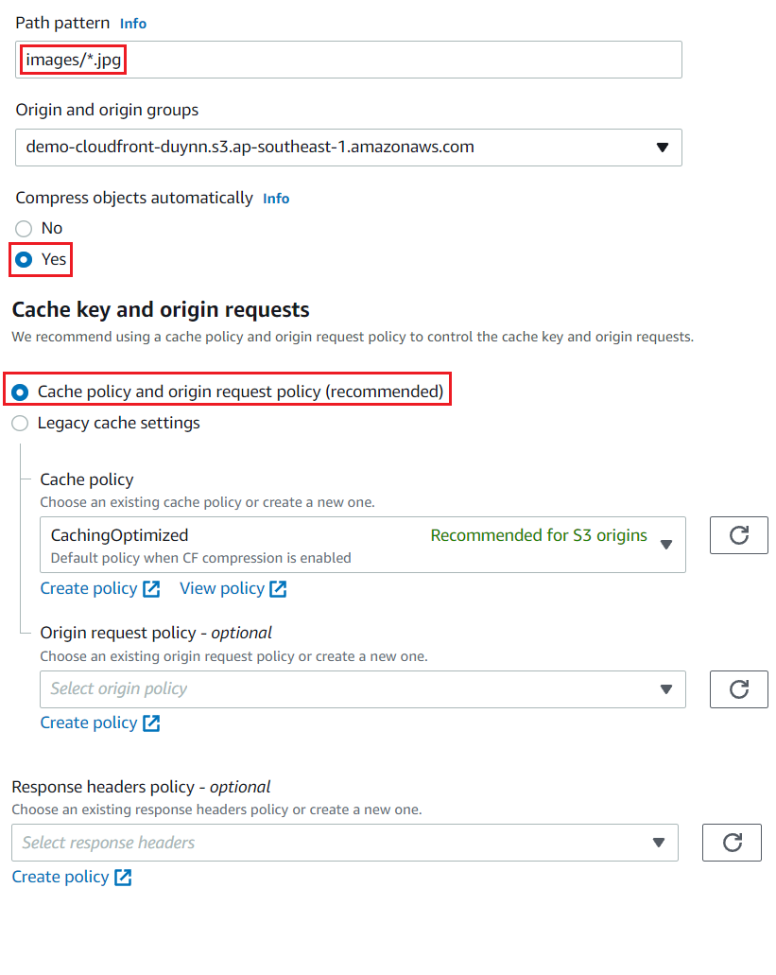
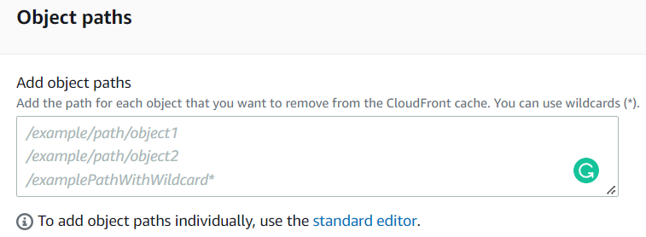
CloudFront Service
  Settings
    Cache behavior
      Path pattern
      Each file has a unique key
      Support Compress objects to smaller files 🡺 User can faster, cheaper download
    Invalidation
      Remove cache

Slide 15
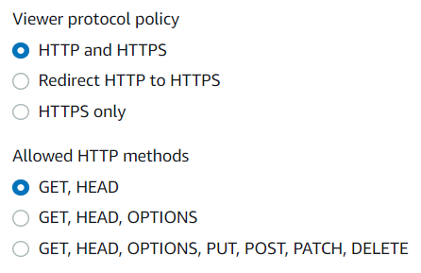
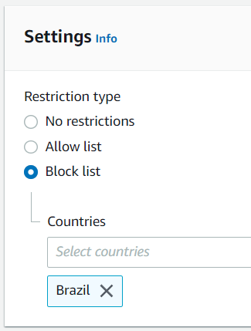
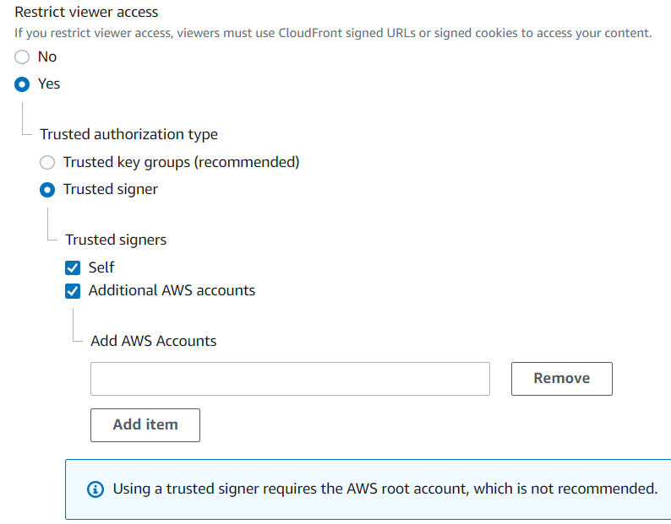
CloudFront Service
    Restrict Viewer access to content
      Config allows requests by HTTP/HTTPs, GET/POST/PUT/DELETE
      Geographic restriction: Allow/block request from countries
      SignedURL & Signed Cookie
        Usecases
          By default, Viewer will access the public URL 🡺 Using to private content
          Distribute paid shared content to premium users over the world
        2 types
          Trusted signer: add accounts (singers)
          Trusted key group: add key-pair

Slide 16
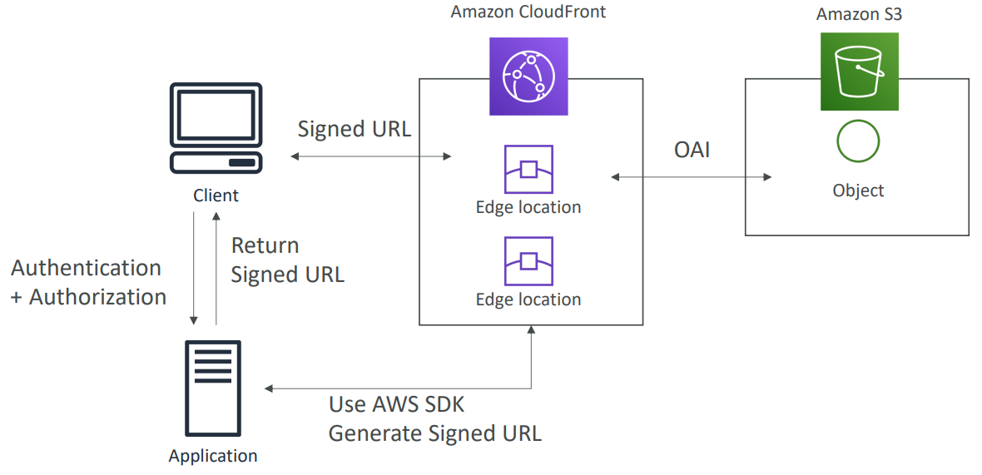
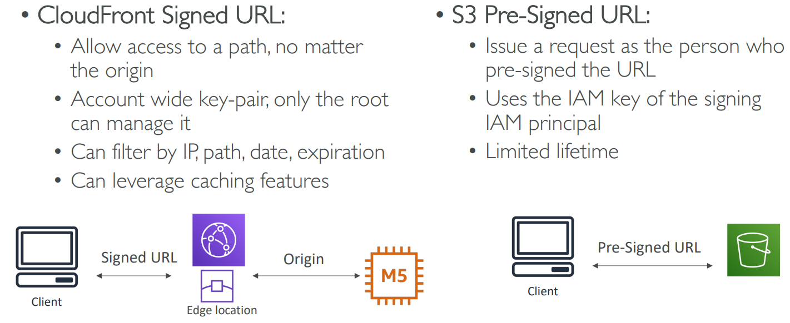
CloudFront Service
        Signed URL
          Usecases: restricting access to single files (1 URL = 1 file) (Ex: file download application)
          Has a higher priority than Signed Cookie,
          Use programming to create
SignedURL will access the link
S3 PresignedURL will access an object

Slide 17
CloudFront Service
        Signed Cookie
          Usecases: restricting access to multiple files (1 Cookie = multiple file), you don’t want to change the URL of file
      S3 Access - Origin access identity (OAI)
        When using CloudFront to get data from S3, User can capture request and access directly from S3 🡺 SignedURL no affect 🡺 Create a CloudFront User (OAI) and assign S3 access to that user 🡺 only CloudFront can access S3

Slide 18
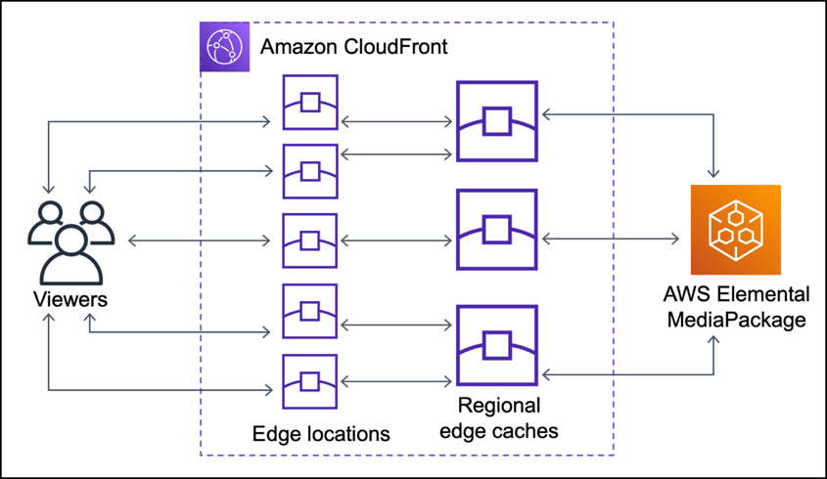
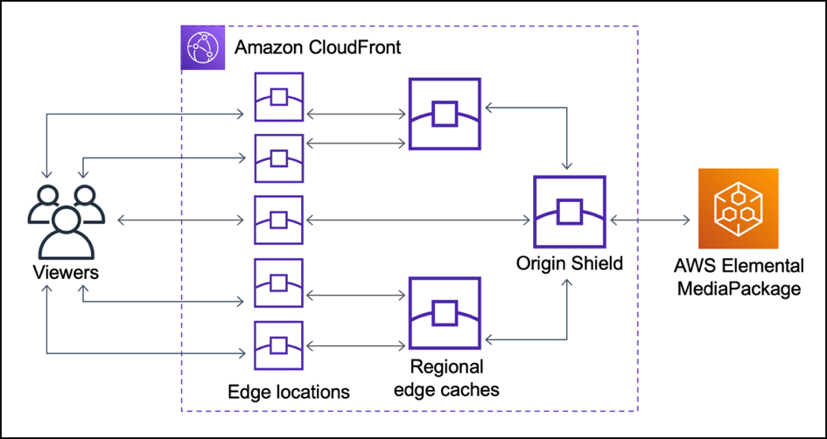
CloudFront Service
    Origin Shield
      Is an additional caching layer before origin to reduce load on origin, better network performance
      Usecases:
        Viewer accesses different regions
        On-premises origin has limited capacity and bandwidth
Without Origin Shield
With Origin Shield

Slide 19
Assignment
  Self-practice

Slide 20
Summary
CloudFront is a CDN (Content delivery network), provide edge locations for caching content
Usecases: Website content (HTTP/HTTPS), On-demand video (VOD), live streaming video
Components: Origin Server & Origin Group, Edge locations
Settings
  Cache behavior & Invalidation
  Origin Shield

Slide 21
Summary
  Restrict Viewer access to content
    HTTP/HTTPs, GET/POST/PUT/DELETE
    Geographic restriction
    SignedURL & Signed Cookie
    S3 Access - Origin access identity (OAI)

Slide 22
Q & A
Copyright © VTI Academy All Rights Reserved

